Slide 1
Tasks

Slide 2
To schedule a task we need to mention warehouse name
Snowflake managed computer resource…
No need to mention the warehouse name
Create or replace task ….if u want to metion vwh (then mention warehouse name)
Schedule (cron / time)
After..command (after the depedent task name)
Create a task
Alter a task (add or remove dependency)
Task will be initially suspended …need to resume task

Slide 3
Alter task task name for modify schedule as well
Alter task for resume or suspend state
Alter task for resume
DAG of tasks (task a, task b, task c,. Task d) create
Dependency between dags (task a schedule it)
Task b, task c, task d will run after completion of task a
Task history: in a day how many times it ran
To see the results for the task hisroty for particular time or in general task history (information_schema task history)

Slide 4
cloning
Cloning refer to zero copy cloning
Really doesn’t physically copy data
Clone can be created for tables, schemas and database
We usually clone the tables very rarely schemas and databases
Main concept : no need to duplicate the storage files on other disk
Underlying data will be available in the tables
It just refers to the clone table
No need to pay for the cloned tables

Slide 5
stages
How to validate the data once it is landed to stage
Scenario 1 :
We have been getting files from third party (files in json/csv)
Discrepancies in data
We have used internal and external stage
Once data landed into stage, snow feature has a functionality
Copy into command help us to load inti table with validation
I want to purge the file
Before loading data into table I just wanted to check whether I can load the data into table
Return all errors
It understand the structure and tells us these are the possible errors u take care before loading the data
Preventing from loading bad data
Data quality checks

Slide 6
caching
Caching one of the very good feature of SF
Query result
Virtual wh cache
Meta data cache
Here, in SF caching (results of every query executed it will cached for the session)
It will go and check whether the same query is getting executed
so it will go and take the results from cache
Instead of scanning the whole table and getting the results
That’s the way cache saves out time and it wont costs to pick the data from result set

Slide 7
Time travel
Scenario:
While doing unit test…two developers
Lots of tables being involved
Snapshots used by me was changed by my colleague unintentionally
Then we came to know something wrong
Sf has concept of time travel
Just wanted to know what query another develop has executed at what time
To revert back that data into original form
Within 7 days…(we felt , data missing is within one or two days ) so by providing the time in time travel
We revert back the data into dummy table and loaded into main and did the unit testing
That’s way the time travel helped us to bring back the data into original where data missing unintentionally by someone
to continue the unit testing

Slide 8
Why sf cdc separately … when that is available in etl
Before sf…we were with etl
We perform transformations, validations and dcd capture everything we had
So.. We used multilple components …
Customer data is not there , if there is a new data we have to keep it as new record
So.. it was an hectic task to move into sf
To eliminate the complextiy of etl cdc
I also built concept ..called streams to understand the cdc
Whatever cdc we have used in etl can be implemented using SF streams
As we had lot many jobs …full fledged sf solution
We are going for cdc sf

Slide 9
Marketing team needs some data come out with churn analysis without an account how can u supply the data and revert it when the purpose os served
New joiners (for them) secure data sharing
Secure data getting shredded who doesn’t have account
Create a share on particular table
We can create a databases/ views/ and share with them
Data sharing in SF in parallel continue the work
Specific roles and specific restrictions we create on table or views to use the data .

Slide 10
Layers
Cloud service
Query processing (scale down / d
Database storage (bottom layer)
It stores all kind of data
Results caches it can store
It is scalable (no limit) ..gcp/aws/azure
Query processing and data base storage
Both can independently grow…
Need more compute and less strorage and vice versa
They are independent of each other

Slide 11
task
Task is an orchestration tool in sf
Cannot find on other data warehouses
big query has own scheduling
Tasks concept from sf…u can write all codes, u can assign dependencies
Stroe_proc 1 write command to stop at 10 mins ans for other taskes as well
It is limited to sf
Cannot be used outside sf
If you are going with fullf ledged sf sloutions this is the best

Slide 12
Difference between materaliazed views and normal views
Instead of writing query everytime write views it goes inside the table and fetch everytime
Materilzed views (it takes from the cache results)
Output getting from materialized views faster results than the normal views
Table that are not changing frequently can use … materiliazed views

Slide 13
What are the source systems in ur project how you are integrating with sf

Slide 14
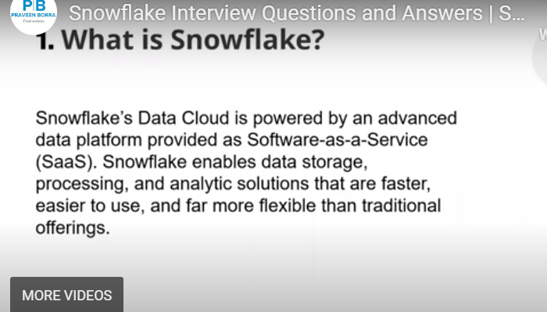
Interview questions section 2

Slide 15
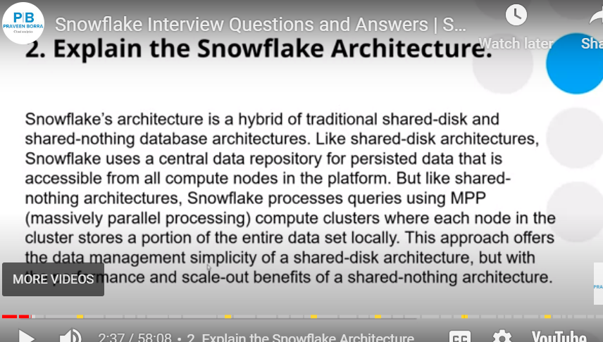

Slide 16
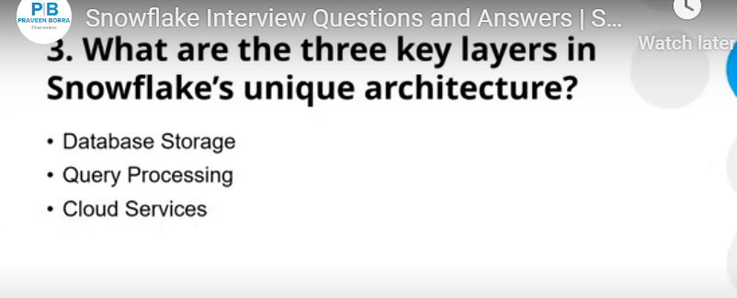

Slide 17
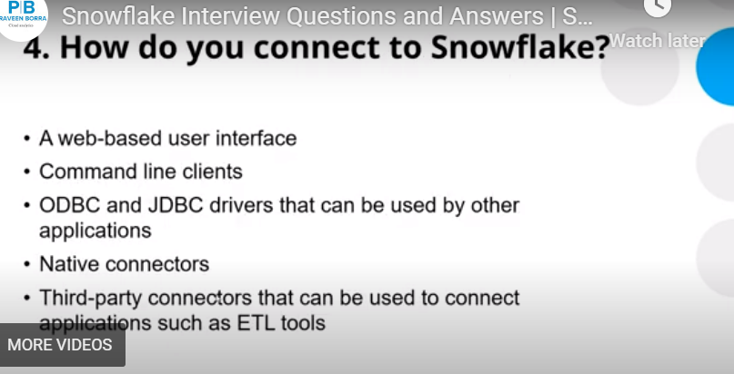

Slide 18
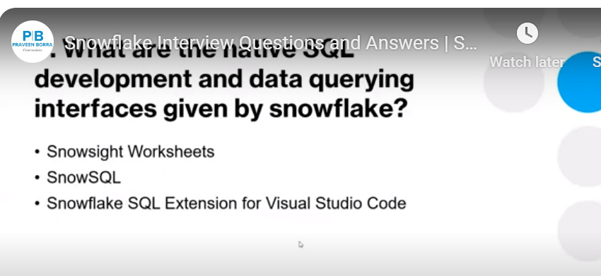

Slide 19
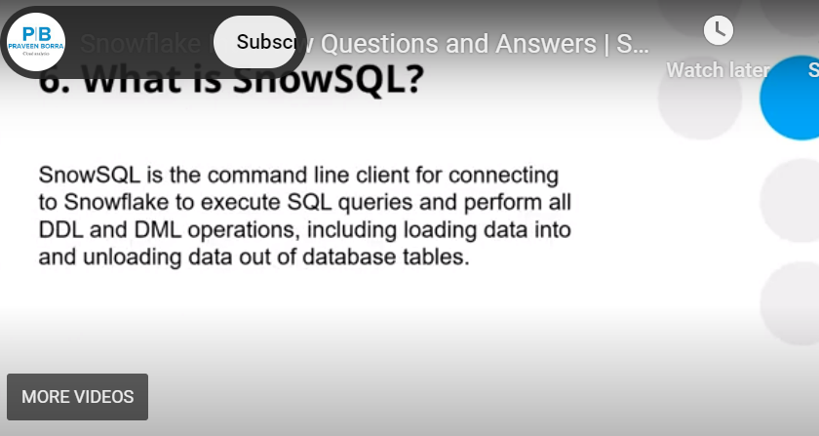

Slide 20
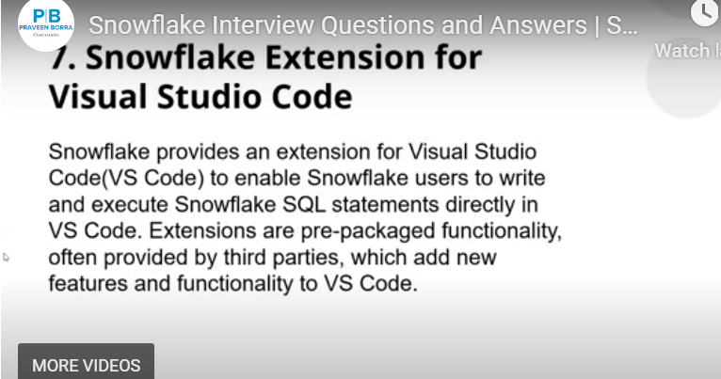

Slide 21
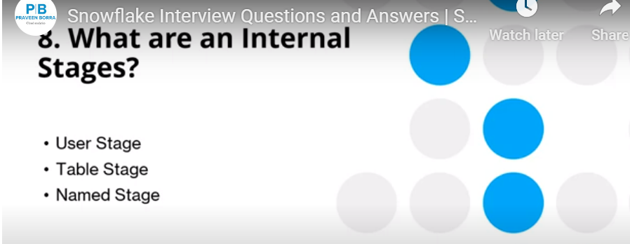

Slide 22
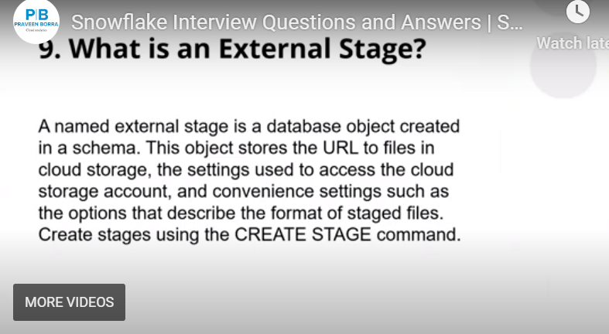

Slide 23
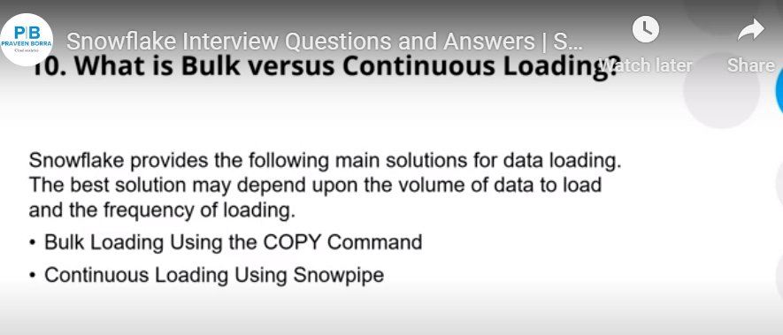

Slide 24
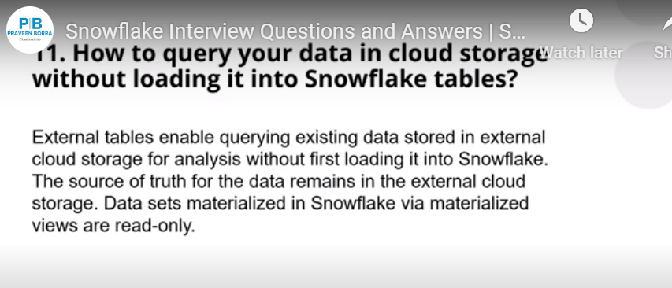

Slide 25
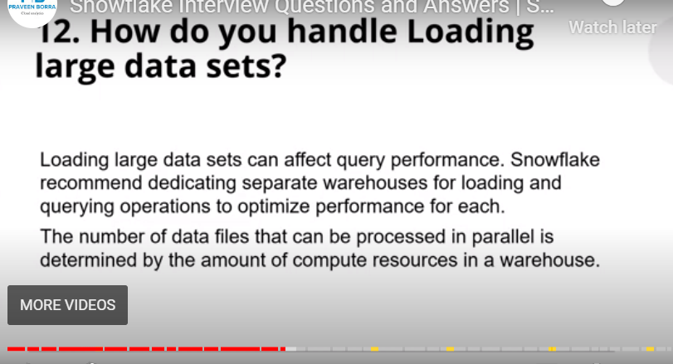

Slide 26
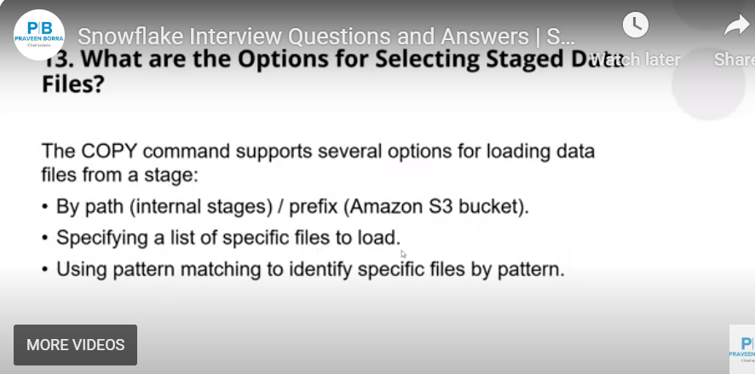

Slide 27
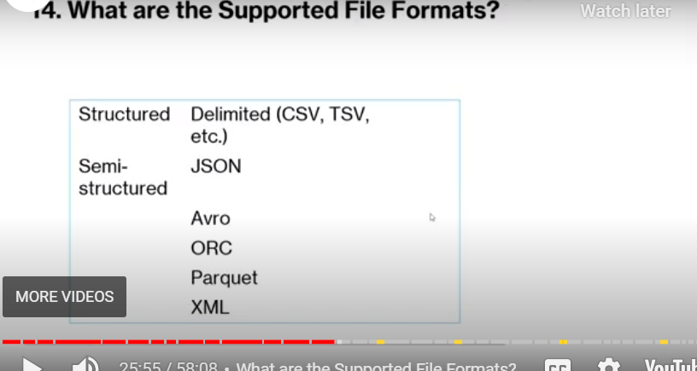

Slide 28
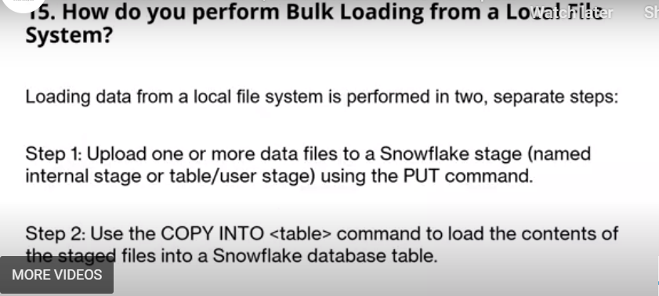

Slide 29
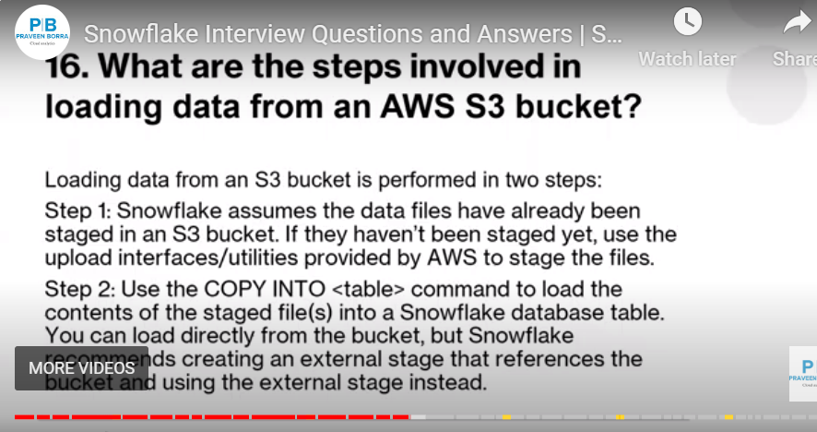

Slide 30
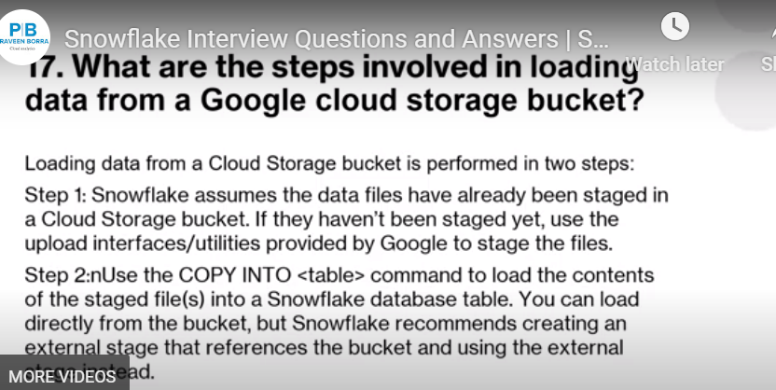

Slide 31
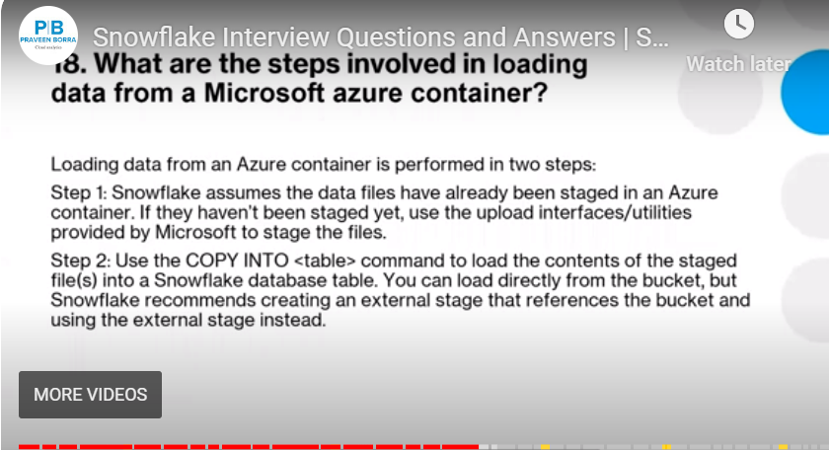

Slide 32
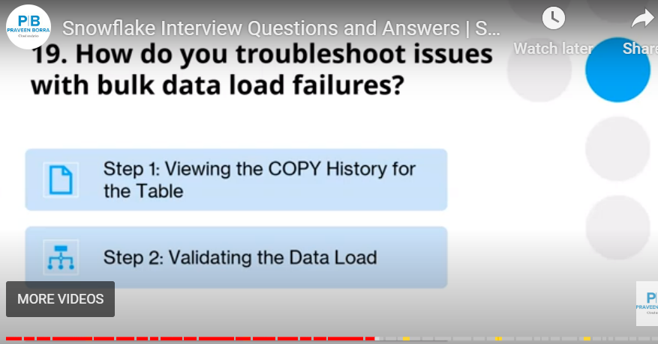

Slide 33
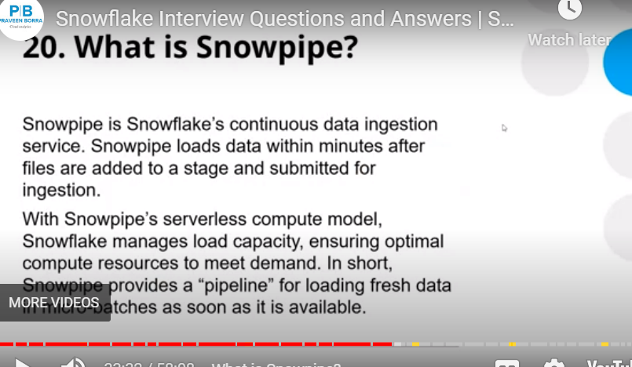

Slide 34
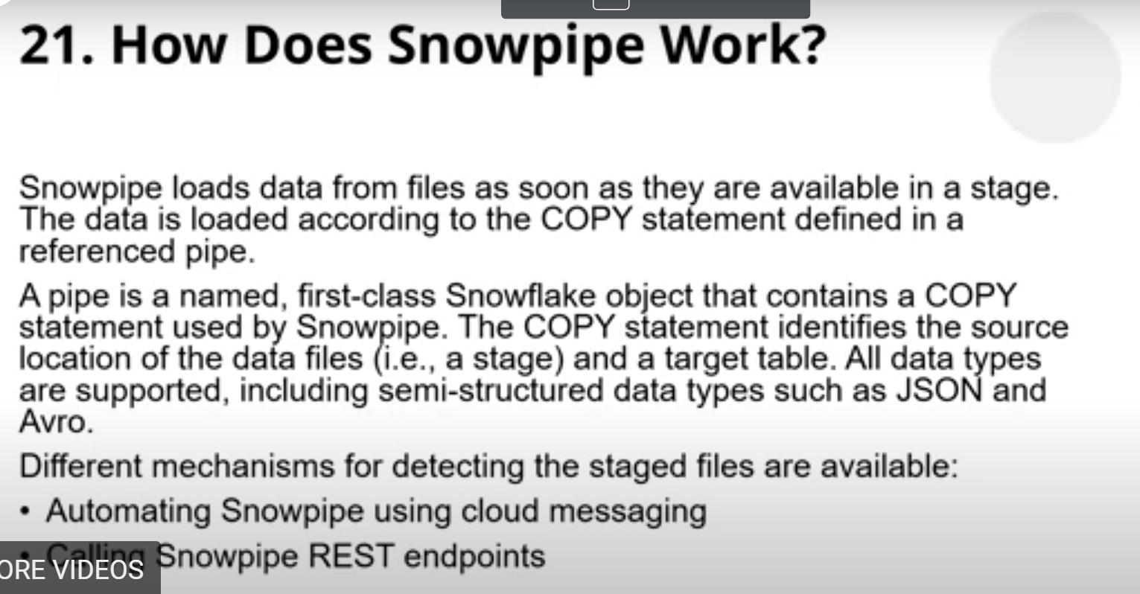

Slide 35
Can event notifications be used to trigger Snowpipe?
Automated Snowpipe uses event notifications to determine when new files arrive in monitored cloud storage and are ready to load. Notifications identify the cloud storage event and include a list of the file names. They do not include the actual data in the files.

Slide 36
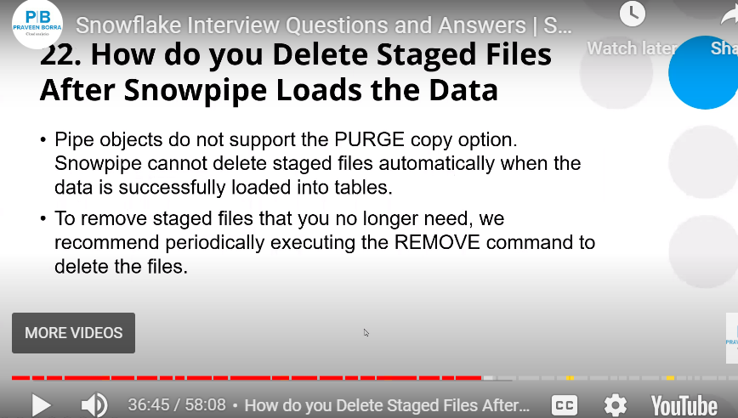

Slide 37
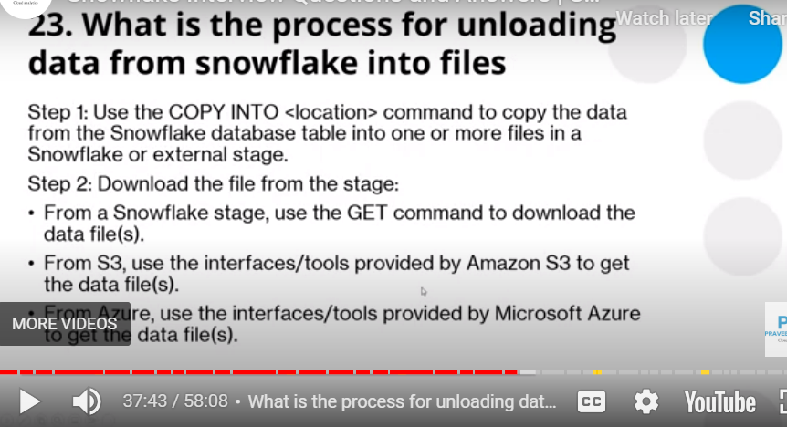

Slide 38
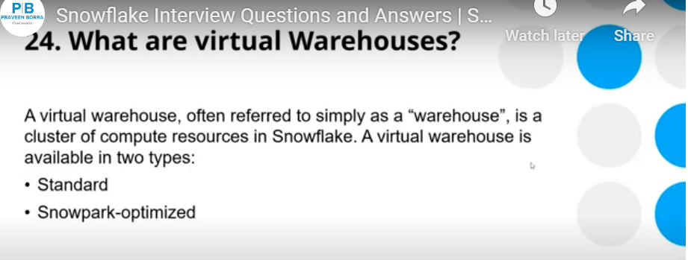

Slide 39
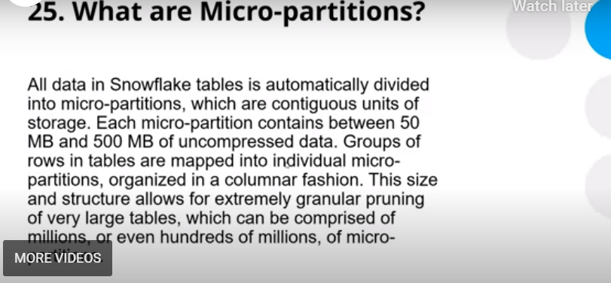

Slide 40
